Slide 1
Gun control
Yihang sun

Slide 2

Introduction

Slide 3
Data
1.I will use the data 'More Guns, Less Crime?' from R Data Sets.It includes 1173 rows and 13 columns.This data will use csv format.
2.Another source is scraping of a web page from https://everytownresearch.org/report/gun-violence-in-america/.

Slide 4
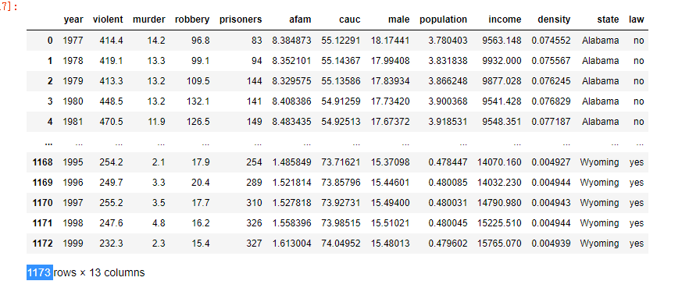
data content

Slide 5
Research Questions
Which factor has the highest effect for gun violence? Many factors can affect the gun violence, such income, gender and others. Which factor has the highest effect?
Can Law of control guns solve the Gun violence? Legislation at the federal, state, and local levels has attempted to address gun violence through a variety of methods.Is the way effective?

Slide 6
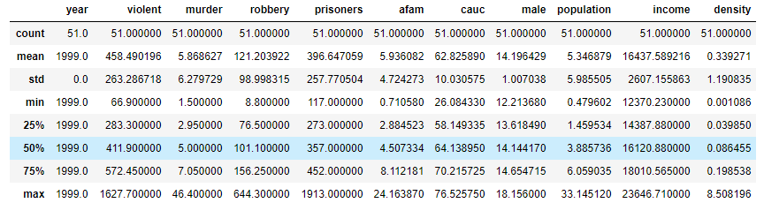
statistical analysis

Slide 7
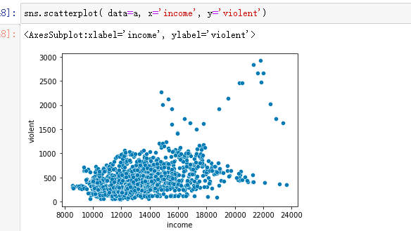
income facts

Slide 8
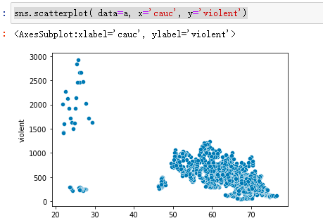
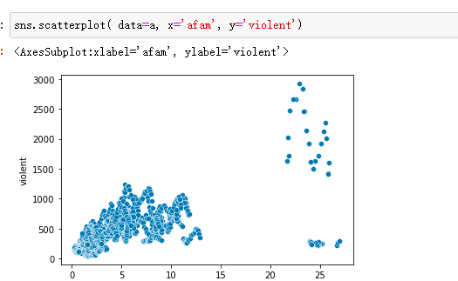
Race facts

Slide 9
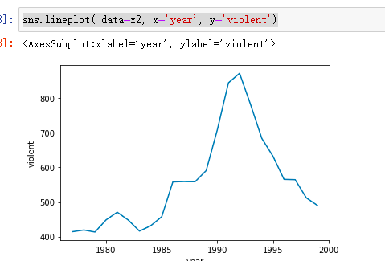
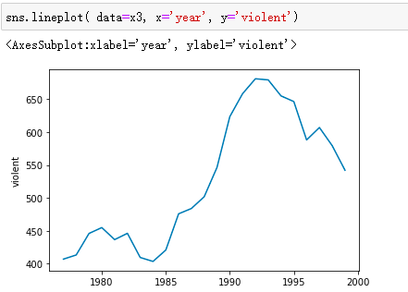
Year facts Alabama and North Carolina

Slide 10
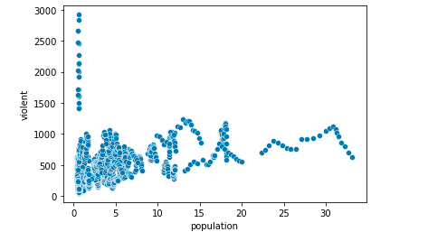
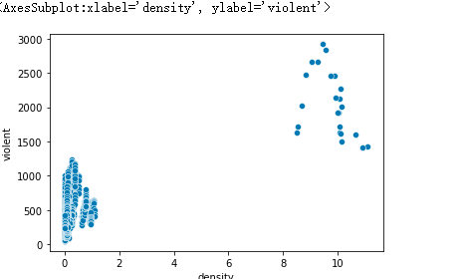
Population and density facts

Slide 11
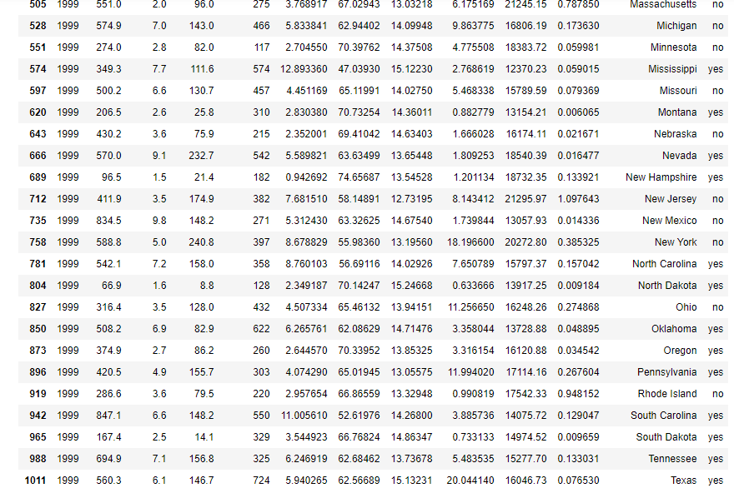
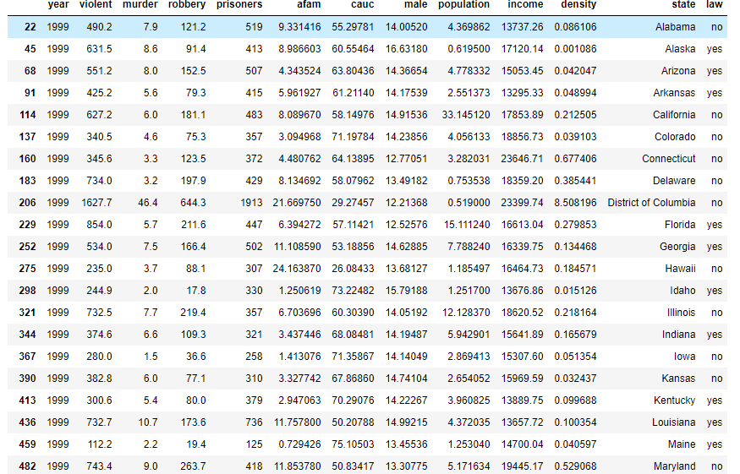
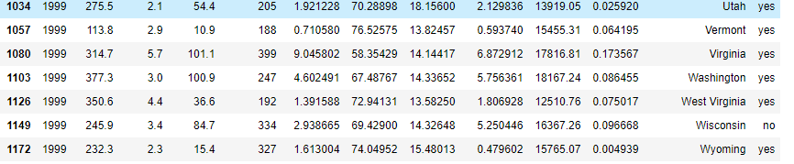
LAW facts

Slide 12
Florida:3051.6020910978264 Ohio:1151.0979815766111

Slide 13
conclusions
Year, Population facts is not
Race ,income, density have influence.
Law can’t solve the gun violent problems.

